Slide 1


















OpenDRR Platform
RiskProfiler
CGP
Open Data
F/P/T Portals
Provide tools to facilitate decision making prior to and during a crisis
Emergency Theme
Key Components
OpenQuake Engine
GitHub Data Repository
Federal Geospatial Platform (FGP)
Public Portal (RiskProfiler.ca)
Kibana
OGC API
FGP
CSW
Elasticsearch
FGP GCC
OGC
Esri REST
WPS (CZS)
PostGIS
Risk Analyst
Emergency Planner, Risk Manager
GitHub pages
GC User
Models
Datasets
Documentation
OpenQuake Engine
OpenDRR GitHub
Public

Slide 2
What we can provide
Data
Earthquake risk layer
Social vulnerability layer
Global human settlement layer
Modest budget for Cloud infrastructure
Can contribute to developing the ”Emergency” theme in CGP
Can strengthen the collaboration with key shared stakeholders (e.g. GeoBC)
Can build on existing GSC presence on FGP

Slide 3
Requirments
Interoperability
OCG map services (WMS, WFS)
Esri REST services
OGC catalogue services (CSW)
Data Access
Clip-Zip-Ship
Data Sharing
CGP
Open Data
P/T partners
Metadata
HNAP metadata compliance
Metadata management
Cloud (UCLL)
DEV, STAGING, PROD for RiskProfiler
FGP GCC for interoperability services
Assistance with architecture and deployment

Slide 4
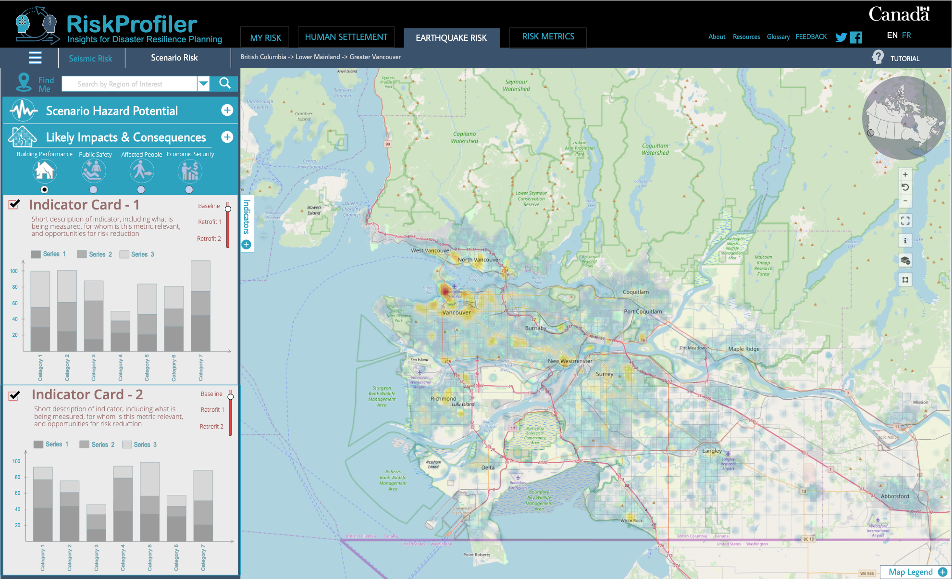
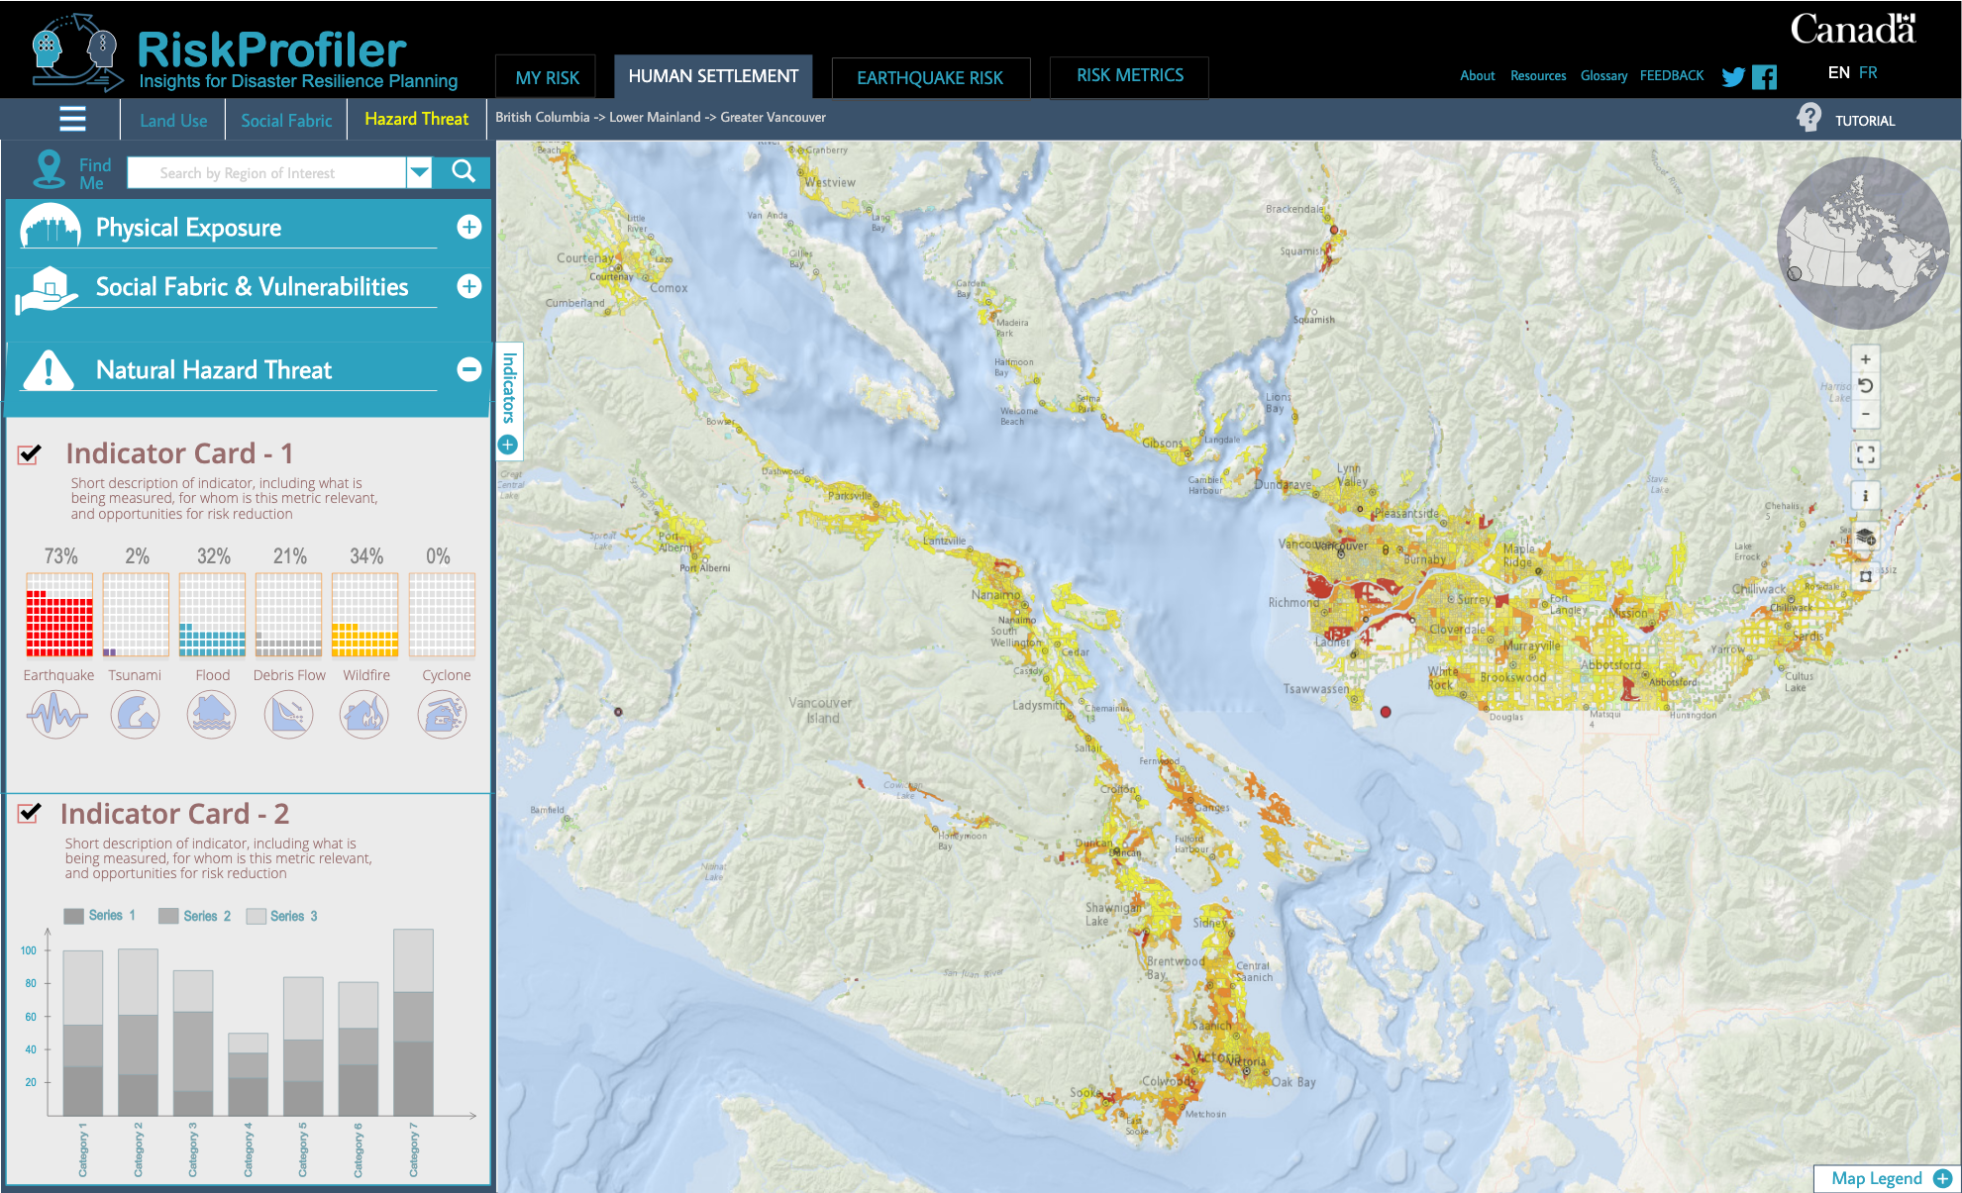
RiskProfiler.ca
Purpose-built web application for non-experts
High-level overview of hazard risk
Interactive maps and graphic visualizations with supporting text
Contact points for more information about hazard risk

Slide 5
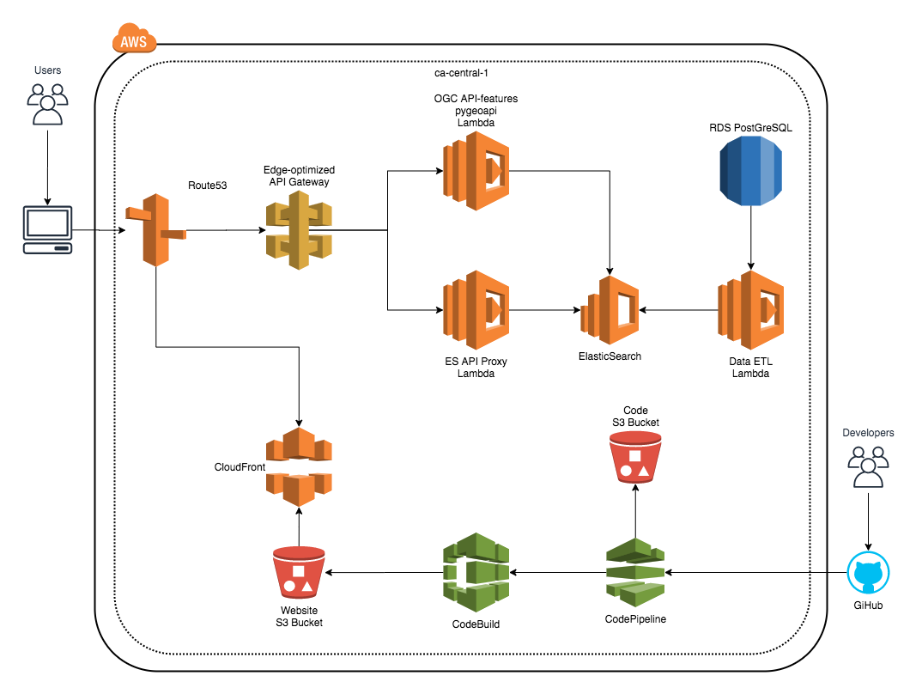
RiskProfiler Cloud Deployment

